Slide 1
Class 3rd c#
C# Function

Slide 2
What is Function
Function is a block of code that has a signature. Function is used to execute statements specified in the code block. A function consists of the following components:
Function name: It is a unique name that is used to make Function call.
Return type: It is used to specify the data type of function return value.
Body: It is a block that contains executable statements.

Slide 3
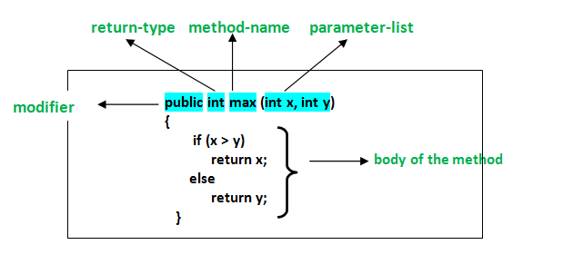
Syntax of method

Slide 4
In C# a method declaration consists of the following components as follows :
Modifier : It defines access type of the method i.e. from where it can be accessed in your application. In C# there are Public, Protected, Private access modifiers.
Name of the Method : It describes the name of the user defined method by which the user calls it or refer it. Eg. GetName()
Return type: It defines the data type returned by the method. It depends upon user as it may also return void value i.e return nothing
Body of the Method : It refers to the line of code of tasks to be performed by the method during its execution. It is enclosed between braces.
Parameter list : Comma separated list of the input parameters are defined, preceded with their data type, within the enclosed parenthesis. If there are no parameters, then empty parentheses () have to use out.

Slide 5
What is signature
signatures enable the overloading mechanism of members in classes, structs, and interfaces. 1. A method signature consists of the name of the method and the type and kind, such as value or reference. A method signature does not include the return type, nor does it include the params modifier that may be specified for the last parameter. 2. A constructor signature consists of the type and kind, such as value or reference. A constructor signature does not include the params modifier that may be specified for the last parameter. 3. An indexer signature consists of the type. An indexer signature does not include the element type. 4. An operator signature consists of the name of the operator and the type. An operator signature does not include the result type. .

Slide 6
Examples
void MyFunc(); // MyFunc () void MyFunc(int x); // MyFunc (int) void MyFunc(ref int x); // MyFunc (ref int) void MyFunc(out int x); // MyFunc (out int) void MyFunc(int x, int y); // MyFunc (int, int) int MyFunc(string s); // MyFunc (string) int MyFunc(int x); // MyFunc (int) void MyFunc(string[] a); // MyFunc (string[]) void MyFunc(params string[] a); // MyFunc (string[])

Slide 7
NOTES
The ref and out parameter modifiers are part of a signature. MyFunc(int), MyFunc(ref int), and MyFunc(out int) are all unique signatures. The return type and the params modifier are not part of a signature, and it is not possible to overload based solely on return type or on the inclusion or exclusion of the params modifier. Notice that there are some errors for the methods that contain duplicate signatures like MyFunc(int) and MyFunc(string[]) whose multiple signatures differ only by return type.

Slide 8
Types of method or function
1. Without Parameters & Without Return Type
2. Without Parameters & With Return Value Type
3. With Parameters & Without Return Value Type
4. With Parameters & With Return Value Type

Slide 9
Advantages of using the Methods :
There are many advantages of using methods. Some of them are listed below:
1. It makes the program well structured.
2. Methods enhance the readability of the code.
3. It provides an effective way for the user to reuse the existing code.
4. It optimizes the execution time and memory space.

